Slide 1
Bioinformatics
COMSATS University Islamabad, Sahiwal Campus

Slide 2
GROUP 10
Awais Javed
Usama Sarwar
FA17-BCS-077
FA17-BCS-090
Atta Ul Mustafa
Umar Daraz
FA17-BCS-076
FA17-BCS-065
TEAM
Mustansar
Usman Naeem
FA17-BCS-089
FA17-BCS-070
Aehtsham Khan
Muhammad Anas
FA17-BCS-097
Group Leader
FA17-BCS-083
Usama Sarwar

Slide 3
Klebsiella pneumoniae
CG43 plasmid pLVPK
Getting TWO Proteins Sequences
Containing TWO different Domains

Slide 4
Proteins
Proteins are large biomolecules, or macromolecules, consisting of one or more long chains of amino acid residues. Proteins perform a vast array of functions within organisms, including catalyzing metabolic reactions, DNA replication, responding to stimuli, providing structure to cells, and organisms, and transporting molecules from one location to another. Proteins differ from one another primarily in their sequence of amino acids, which is dictated by the nucleotide sequence of their genes, and which usually results in protein folding into a specific 3D structure that determines its activity.

Slide 5
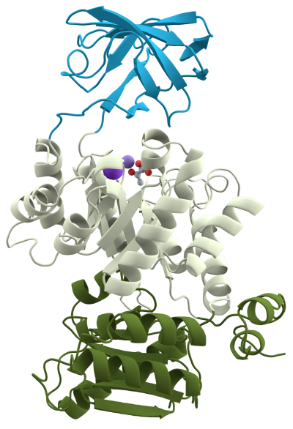
Protein Domains
Many proteins are composed of several protein domains, i.e. segments of a protein that fold into distinct structural units. Domains usually also have specific functions, such as enzymatic activities (e.g. kinase) or they serve as binding modules.

Slide 6
HOW TO
PROTEIN DOMAIN

Slide 7
Prerequisites
UniProt
01
UniProt is a freely accessible database of protein sequence and functional information, many entries being derived from genome sequencing projects.
FASTA Sequence
02
In bioinformatics and biochemistry, the FASTA format is a text-based format for representing either nucleotide sequences or amino acid sequences, in which nucleotides or amino acids are represented using single-letter codes.
HMMER Tool
03
Biosequence analysis using profile hidden Markov Models
Protein sequence VS Profile-HMM database
Pfam
04
Pfam is a database of protein families that includes their annotations and multiple sequence alignments generated using hidden Markov models.

Slide 8

Steps to find Protein Domain
Copy the FASTA sequence and save it somewhere.
Get Protein Domains and other Results
All Done!
UniProt
HMMER
FASTA
Domains
Visit UniProt
HMMER Tool
Search
“Klebsiella Pneumoniae”
In UniProtKB
After pasting FASTA Sequence; click on Submit.

Slide 9
TUTORIAL

Slide 10
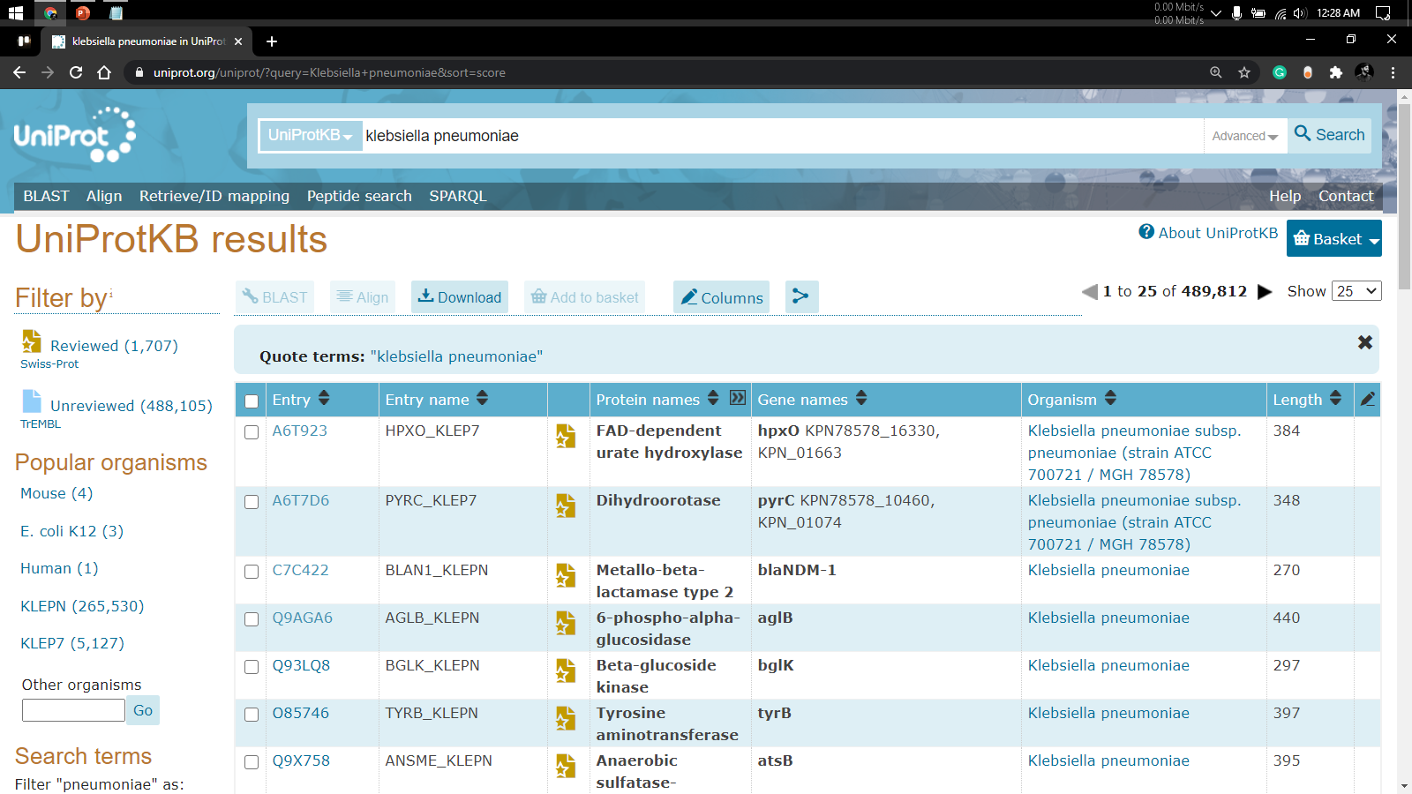
1
You can simply impress your audience and add a unique zing and appeal to your Presentations. Easy to change colors, photos and Text. Get a modern PowerPoint Presentation that is beautifully designed. You can simply impress your audience and add a unique zing and appeal to your Presentations. Easy to change colors, photos and Text. Get a modern PowerPoint Presentation that is beautifully designed.
Modern Portfolio Presentation
2

Slide 11
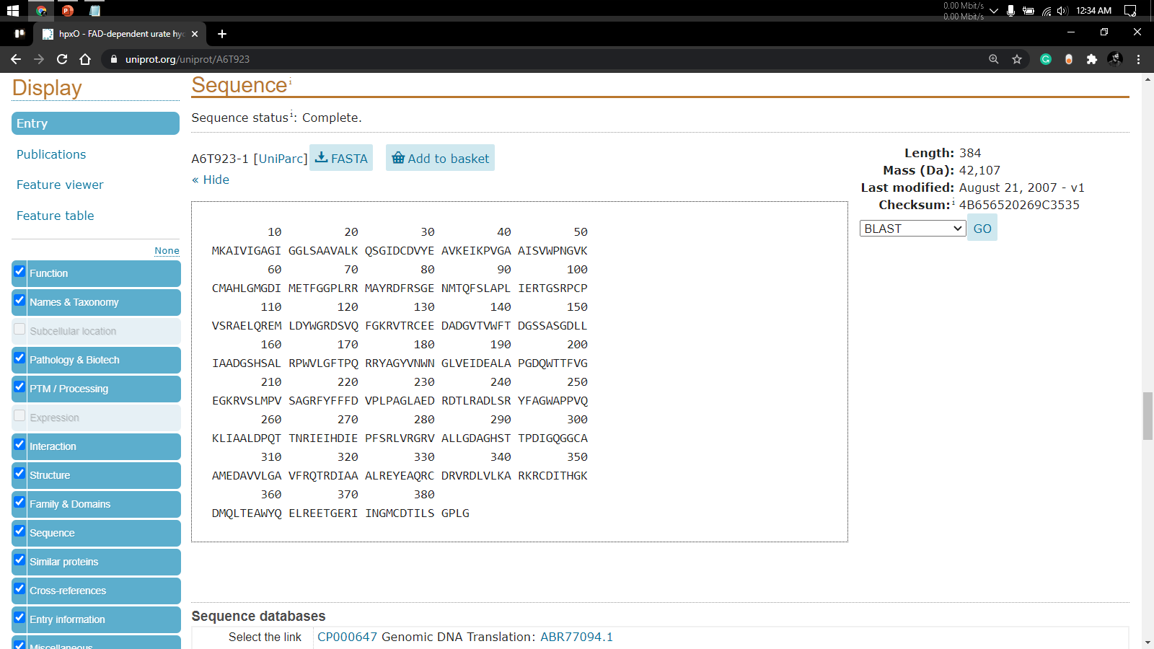
3
You can simply impress your audience and add a unique zing and appeal to your Presentations. Easy to change colors, photos and Text. Get a modern PowerPoint Presentation that is beautifully designed. You can simply impress your audience and add a unique zing and appeal to your Presentations. Easy to change colors, photos and Text. Get a modern PowerPoint Presentation that is beautifully designed.

Slide 12
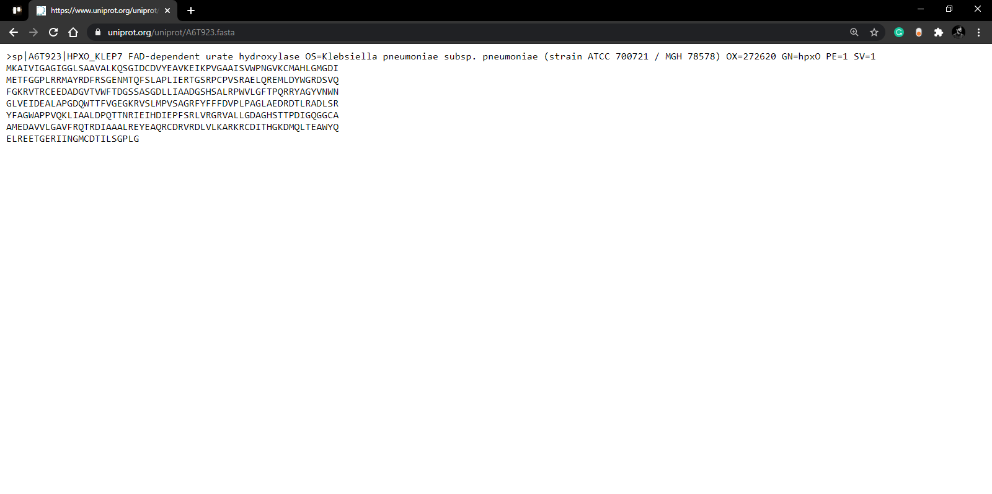
You can simply impress your audience and add a unique zing and appeal to your Presentations. Easy to change colors, photos and Text. Get a modern PowerPoint Presentation that is beautifully designed. You can simply impress your audience and add a unique zing and appeal to your Presentations. Easy to change colors, photos and Text. Get a modern PowerPoint Presentation that is beautifully designed.
4

Slide 13
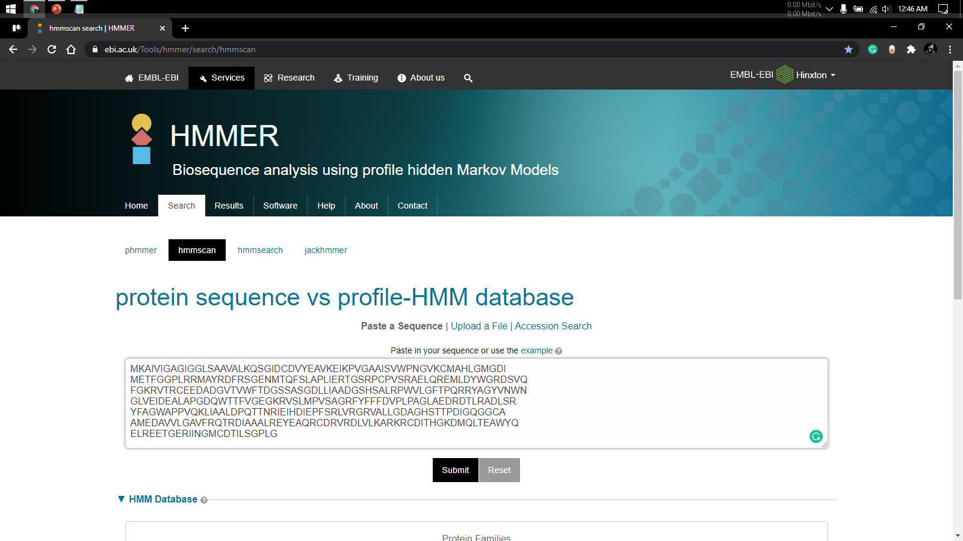
You can simply impress your audience and add a unique zing and appeal to your Presentations. Easy to change colors, photos and Text. Get a modern PowerPoint Presentation that is beautifully designed. You can simply impress your audience and add a unique zing and appeal to your Presentations. Easy to change colors, photos and Text. Get a modern PowerPoint Presentation that is beautifully designed.
5

Slide 14
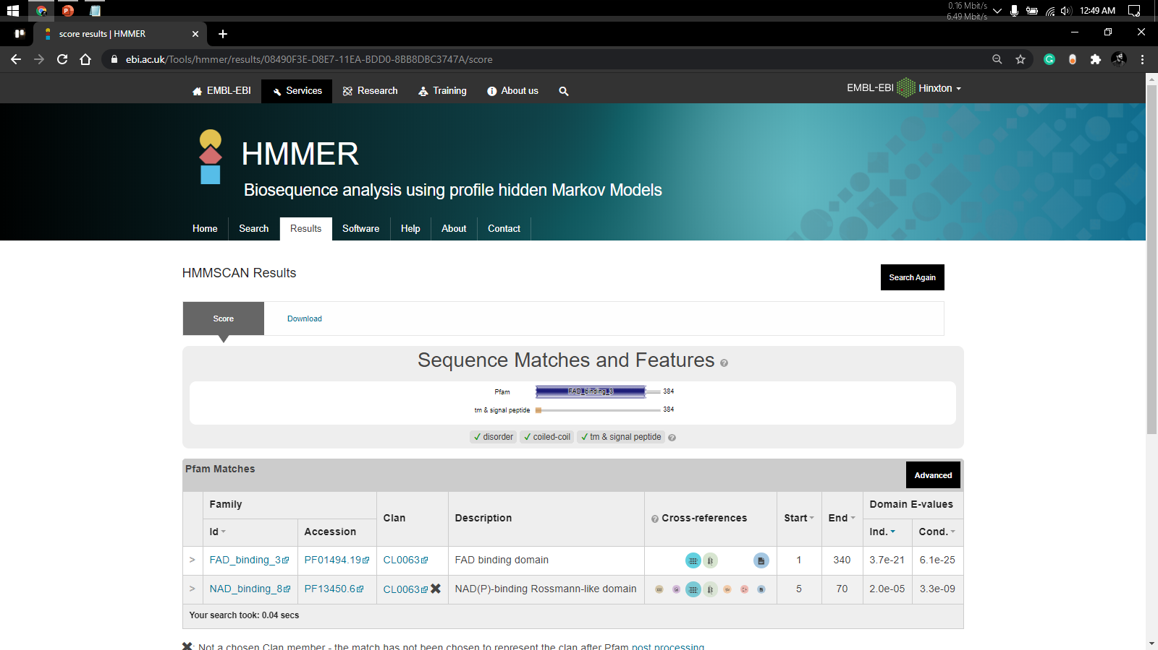
You can simply impress your audience and add a unique zing and appeal to your Presentations. Easy to change colors, photos and Text. Get a modern PowerPoint Presentation that is beautifully designed. You can simply impress your audience and add a unique zing and appeal to your Presentations. Easy to change colors, photos and Text. Get a modern PowerPoint Presentation that is beautifully designed.

Slide 15
You can simply impress your audience and add a unique zing and appeal to your Presentations. Easy to change colors, photos and Text. Get a modern PowerPoint Presentation that is beautifully designed. You can simply impress your audience and add a unique zing and appeal to your Presentations. Easy to change colors, photos and Text. Get a modern PowerPoint Presentation that is beautifully designed.
Modern Portfolio Presentation
6

Slide 16
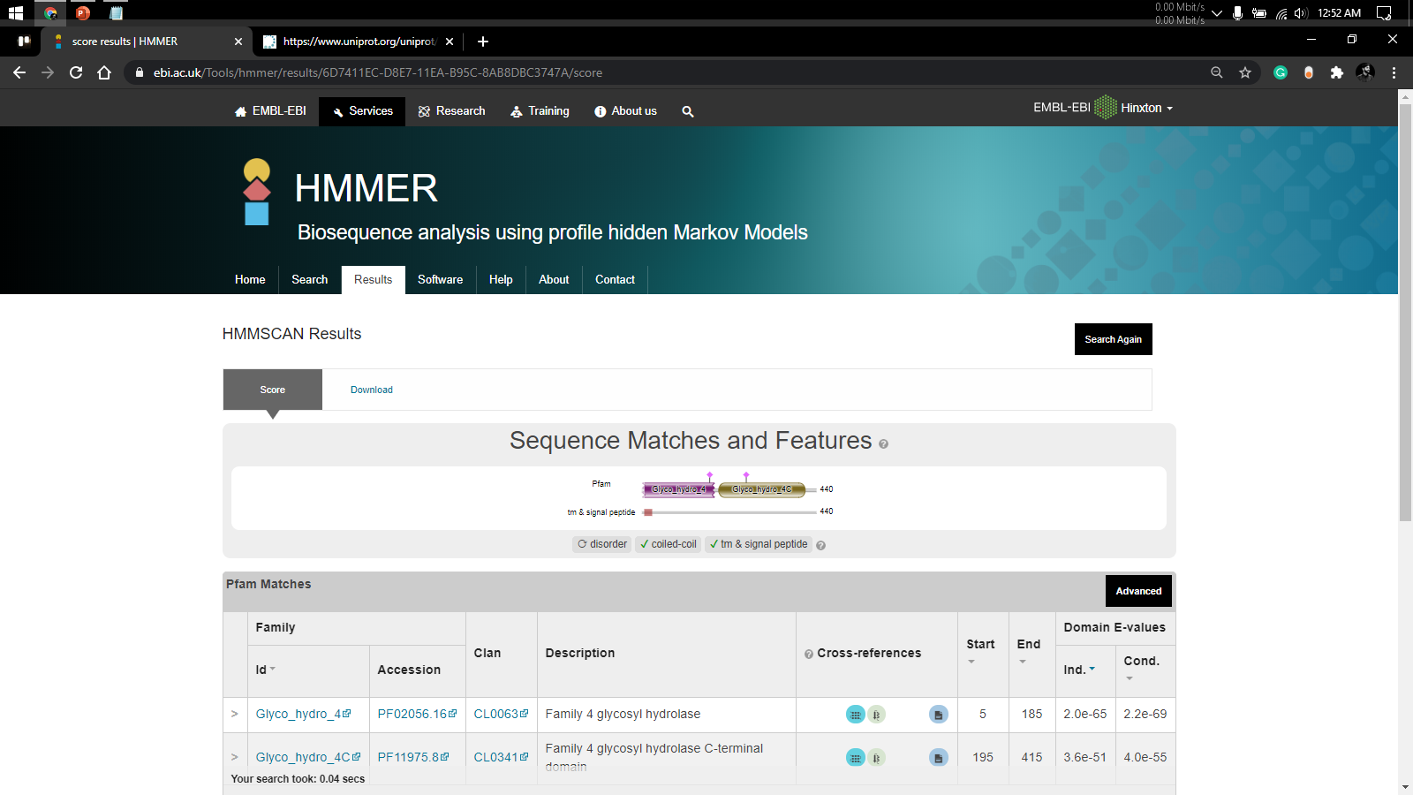
You can simply impress your audience and add a unique zing and appeal to your Presentations. Easy to change colors, photos and Text. Get a modern PowerPoint Presentation that is beautifully designed. You can simply impress your audience and add a unique zing and appeal to your Presentations. Easy to change colors, photos and Text. Get a modern PowerPoint Presentation that is beautifully designed.

Slide 17
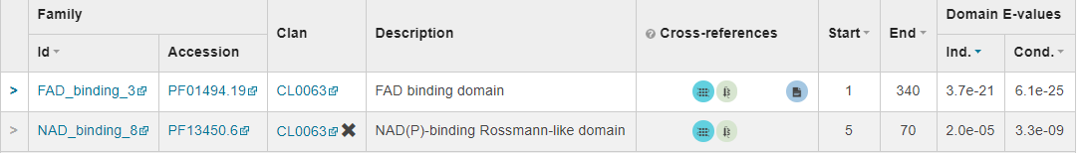
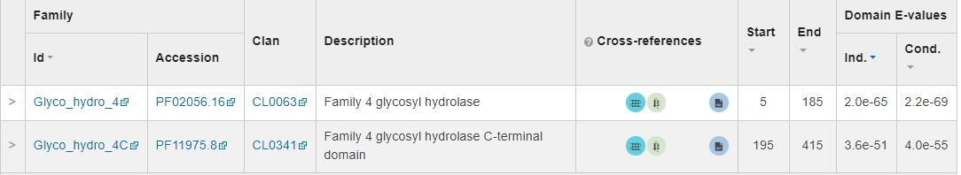
Comparison
Protein A
Protein B

Slide 18
Thank You

